Slide 1

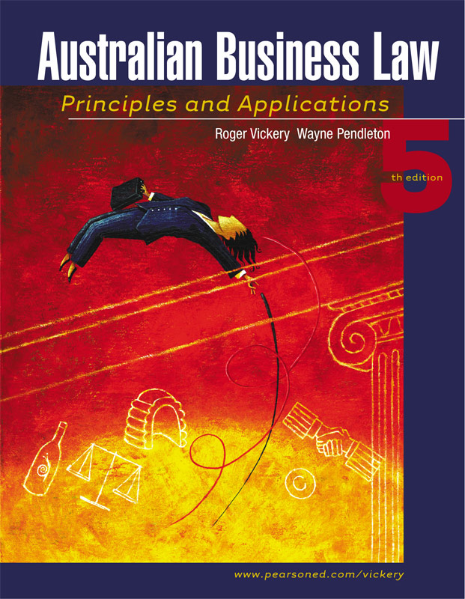
PowerPoint to accompany
0
Roger Vickery
Wayne Pendleton

Slide 2
Chapter 18:
0
Property law: Real Property and mortgages

Slide 3
Real Estate Law
EXPECTED LEARNING OUTCOMES
0
After successfully completing this chapter, you will be able to:
define and distinguish between real and personal property;
define what is meant by land and the rights of a landowner;
distinguish between fixtures and non-fixtures;
distinguish between ownership and possession of property;

Slide 4
Real Estate Law
EXPECTED LEARNING OUTCOMES
list the main types of freehold estates;
distinguish between legal and equitable interests;
outline the main features of land ownership in Australia;
define a mortgage and name the parties to a mortgage;
outline remedies for mortgagees and mortgagors.

Slide 5
Real Estate Law
PROPERTY DEFINED
Real Property:
  Land & all that is attached to it.
Personal Property:
  Chattels real - leases over land.
  Tangible objects - Choses in possession.
  Intangible objects - Choses in action e.g. shares.

Slide 6
Real Estate Law
WHAT DOES A LANDOWNER OWN?
The Crown owns minerals in land & controls their use.
Under common law rights over airspace restricted to ‘ordinary use and enjoyment’; Griffiths J Bernstein v Skyviews (1978).

Slide 7
Real Estate Law
FIXTURES VS NON-FIXTURES
Objects not attached to building are non-fixtures.
Major legal tests:
1. Fixed by more than own weight?
2. Intended to be long-term or permanent?
3. Substantial damage if removed?
  If yes, especially to tests 2 & 3, likely to be fixture.
However, each case decided on facts.

Slide 8
Real Estate Law
OWNERSHIP VS POSSESSION
Ownership: Owner can exercise all available legal rights over property.
Possession: Right to maintain exclusive control against every claim except from owner; Armory v Delamirie (1722) - Boy found jewel. Valuer kept it. Court ordered return.

Slide 9
Real Estate Law
OWNERSHIP VS POSSESSION
Landowner usually has best rights to attached property; Ranger v Giffin (1967) - Money found buried under house belonged to new owner, not finder.

Slide 10
Real Estate Law
FREEHOLD ESTATES
1. Fee Simple: Most extensive interest. Owner may sell, lease, mortgage, will or alienate (transfer) interests.
2. Life Estate: All the rights of a true owner, except for the right to sell, for the duration of life.

Slide 11
Real Estate Law
JOINT ESTATES
Land can be co-owned as:
Joint tenancy: Full equal rights. Last survivor gains outright title.
Tenants-in-common: Equal right of possession. Shares can be willed, sold etc.
Tenancy in common is most appropriate ownership, except in close family situations.

Slide 12
Real Estate Law
LEGAL AND EQUITABLE INTERESTS
Legal interest: Recognised by common law (and statute law) e.g. title to land through formal statutory contract.
Equitable interest: Recognised by equity law.
  Both can exist simultaneously on one property.
  Legal interests normally take precendence.

Slide 13
Real Estate Law
OLD SYSTEM VS TORRENS TITLE
Old System title: Based on a continuous chain of documents for at least 30 years.
Torrens title: Based on a state guaranteed register of land. 97% of land now covered by Torrens title.
‘Indefeasibility’ is major feature of Torrens (see following slide).

Slide 14
Real Estate Law
INDEFEASIBILITY
Means a party with registered Torrens title is immune from any other claim.
If title registered through fraud, then:
  Party who obtained title from a "defrauder" and became registered Torrens title holder remains owner if they prove:
    They were "bona fide" (honest) purchaser; (continued next slide)

Slide 15
Real Estate Law
INDEFEASIBILITY
  They paid “fair” price;
  They had no knowledge of the fraud.
Defrauded owner may seek compensation from the state.

Slide 16
Real Estate Law
CAVEATS AND EASEMENTS
Caveat: Document registered on title that warns there is an unresolved claim on land. Most commonly used with equitable interests. Typically blocks any registration of dealings in the land, eg sales.
Easement: Right to make specific use of another person’s land or restrict its use in a specific way, e.g. right of way.

Slide 17
Real Estate Law
COVENANTS
Covenant: Agreement creating a positive or negative obligation, e.g. only double brick houses can be erected on a building estate (negative).
Negative covenants can be binding on future owners.

Slide 18
Real Estate Law
STRATA TITLE
Comes into existence when subdivision plan registered.
Each allotment has own Torrens deed and one issued to Owners Corp. for entire property.
Owners Corp. administers two funds:
  Administrative – To maintain buildings.
  Sinking – For future costs.

Slide 19
Real Estate Law
COMMUNITY TITLE
Strata title has been extended to cover larger areas and to give owners entitlement to use community owned assets, eg halls, golf courses.

Slide 20
Real Estate Law
COMPANY TITLE
Legal title over property remains with corporation.
Shareholders have exclusive right to occupy specific flat/building.
Gives greater control to shareholders (residents) than strata title.
Sale of company title involves sale of shares, not land.

Slide 21
Real Estate Law
CROWN LEASEHOLDS
Crown can grant Torrens title leases ranging from permissive rights to permanent rights to occupy land.
Like any lease, they are subject to conditions and may be terminated if these are breached.

Slide 22
Real Estate Law
MORTGAGES
A mortgage is a contact in which a borrower (mortgagor) gives lender (mortgagee) their real property as security for a loan.
Most mortgages are registered on Torrens Title.

Slide 23
Real Estate Law
OLD SYSTEM MORTGAGES
Created by execution of a deed.
Mortgagee is legal owner. No need to register.
Mortgagor has right to reclaim title.
Later mortgagees obtain only an equitable interest.

Slide 24
Real Estate Law
TORRENS TITLE MORTGAGES
Should be registered on certificate of title.
Mortgagor remains the registered proprietor (legal owner).
Mortgagee gains security over land through a charge (right to payment).
Registered mortgage = Legal interest.
Unregistered mortgage = Equitable interest.

Slide 25
Real Estate Law
EQUITABLE MORTGAGES
Can be created in many ways, eg by depositing title deeds with lender.
Equitable interest usually takes priority over later interests.
Under Torrens title, holder of equitable interest has contractual rights, but cannot exercise control over land.

Slide 26
Real Estate Law
EQUITABLE MORTGAGES
Unregistered mortgage can gain some protection by lodging:
  Mortgage document for registration (even if not in registrable form) and/or;
  Caveat.
  However, see J&H Just (Holdings) Pty Ltd v Bank of New South Wales (1971) on following slide.

Slide 27
Real Estate Law
EQUITABLE MORTGAGES
J&H Just (Holdings) Pty Ltd v Bank of New South Wales (1971) - An equitable mortgagee with a caveat over property lost first rights to it to an earlier, unregistered mortgagee who held the duplicate certificate.

Slide 28
Real Estate Law
RIGHTS OF MORTGAGORS
Under both systems mortgagor has right to sell, lease, will or "alienate" their interest in the land.
However, covenants are usually put in place that require the mortgagee’s consent to such actions.

Slide 29
Real Estate Law
UNCONSCIONABLE MORTGAGES
Mortgage may be unconscionable if:
1. Common law: One party gained unfair advantage and overcame other’s will.
2. Statute law (eg. TPA & NSW Contracts Review Act (1980): One party agreed to unreasonable terms due to factors such as unequal bargaining position; West v AGC Advances Ltd (1986) (see following slide).

Slide 30
Real Estate Law
UNCONSCIONABLE MORTGAGES
2. Statute law (continued): West v AGC Advances Ltd (1986) - West had limited business experience. Entered unfair contract against professional advice. Contract not unconscionable under NSW Contracts Review Act.
Unfair terms do not necessarily make mortgage unconscionable.

Slide 31
Real Estate Law
UNCONSCIONABLE MORTGAGES
3. Special protection for married women: Garcia case (1988) established that a wife who guarantors loan to husband’s business may be exempt from repayments if:
    She did not fully understand terms;
    She lacked sufficient financial interest in the business;

Slide 32
Real Estate Law
UNCONSCIONABLE MORTGAGES
3. Special protection for married women (continued):
  Lender did not ensure she received competent independent advice.

Slide 33
Real Estate Law
MORTGAGEE’S REMEDIES FOR DEFAULT
Under both systems, the mortgagee may:
Sue for breach of contract;
Take possession (eg. right to lease property);
Appoint a receiver;
Foreclose - mortgagee becomes legal and equitable owner (rarely used);
Sell property - main remedy;

Slide 34
Real Estate Law
MORTGAGEE’S REMEDIES FOR DEFAULT
Mortgagor remains liable for any sum owing after sale proceeds distributed;
Mortgagor must provide at least one month’s written notice of intention to sell.

Slide 35
Real Estate Law
POWER OF SALE
Under common law, mortgagees owe a limited duty of good faith to the mortgagor when they sell a property.
Mortgagee must not recklessly sacrifice the mortgagor’s interests.
Failing to adequately advertise the sale can breach this duty; National Commercial Banking Corp of Australia Ltd v Solonowski (1984).

Slide 36
Real Estate Law
POWER OF SALE
In VIC and QLD the mortgagee is required by statute to take all reasonably steps to sell the property at market price, or at the best possible price in their circumstances.
In England and New Zealand the requirement on mortgagees is greater. They must not act negligently and must take reasonable care to obtain a “proper” price.

Slide 37
Real Estate Law
POWER OF SALE
Mortgagees selling property cannot purchase it for themselves.
Nor can they sell it to their solicitors, estate agents or corporation, unless they act honestly and secure a realistic price.
Auction may not always be the most appropriate method; Tse Kwong Lam Case (1983) (see following slide).

Slide 38
Real Estate Law
POWER OF SALE
Tse Kwong Lam Case (1983): Mortgagee’s wife bought valuable Hong Kong property on behalf of family company at public auction. She was sole bidder & reserve price was below value of loan.
Privy Council found mortgagee liable for damages.

Slide 39
Real Estate Law
STATUTORY REQUIREMENTS FOR CORP. PROPERTY SALE
Receivers and liquidators must take all reasonable care to sell the property for:
  Not less than market value, or;
  Best price that is reasonably obtainable.

